Slide 1
Some Fine Tuning

Slide 2
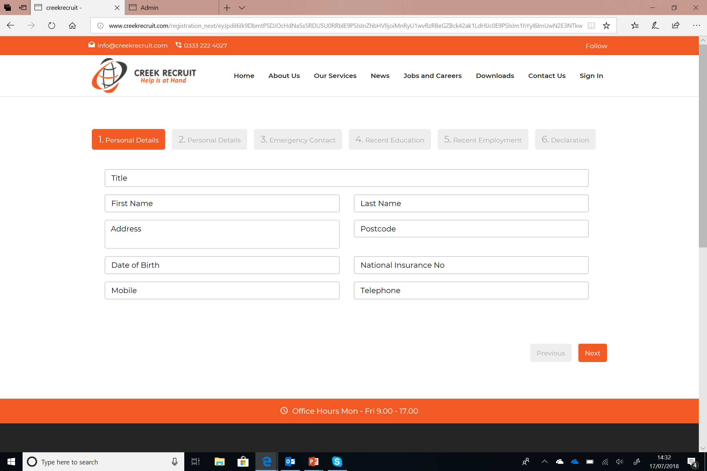
If they enter mobile they don’t have to enter telephone. Basically has to be atleast one.

Slide 3
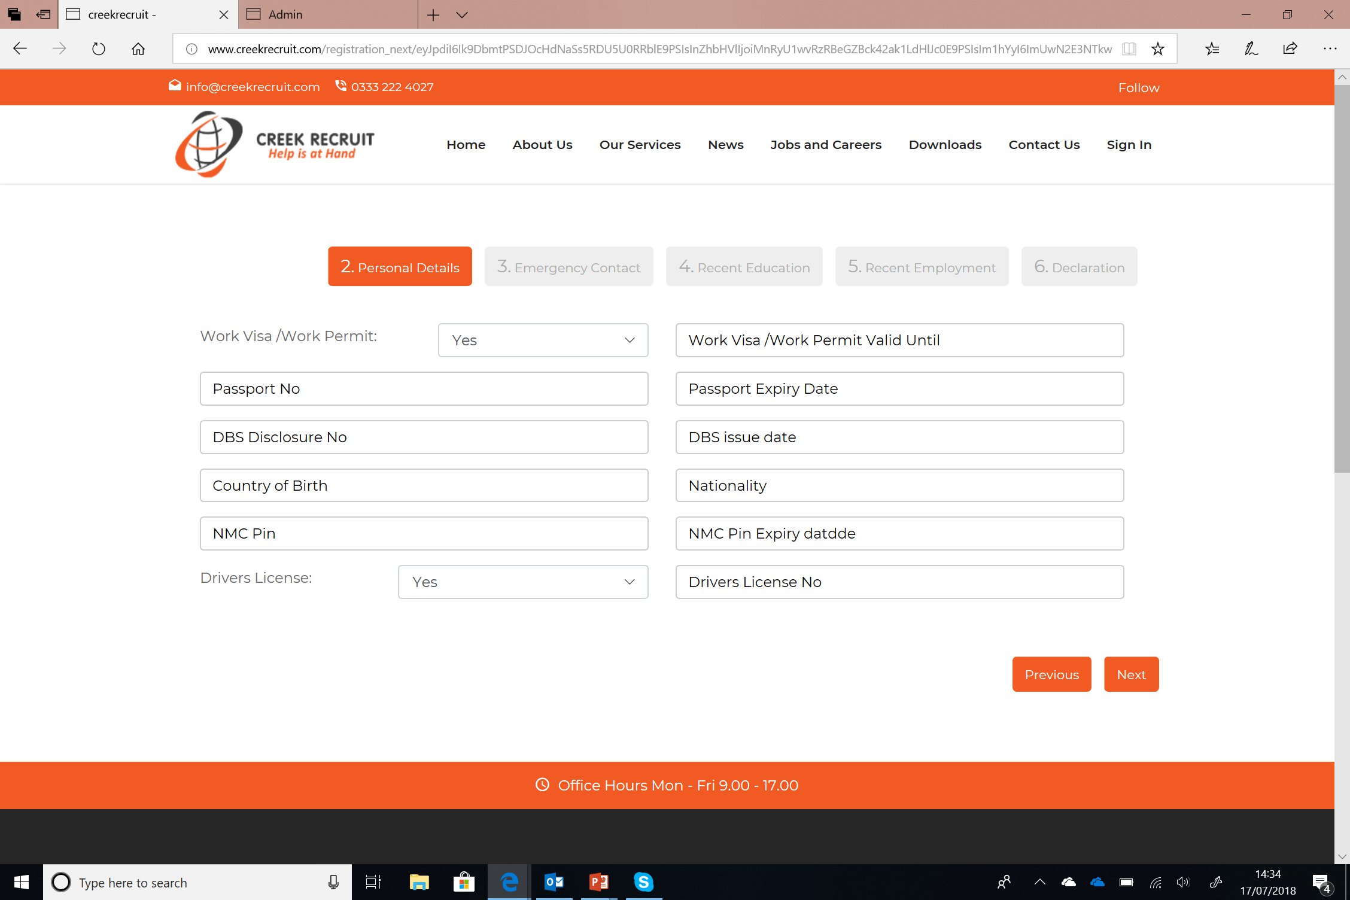
As for the passport Number could we have option of I don’t have which if selected should make expiry date grey out
If Work Permit is No the the Work permit Valid Untill Should be greyed out and should allow click of next
If Driver Licence answer is No the the Driver Licence Number should grey out and allow candidate to click next.
If DBS disclosure is No or negative instead of the number, then issue date should grey or stop being mandatory.
NMC PIN only applies to Nurses, Is it possible to add a drop down that indicates N/A when they hover over the area?
If NMC pin =N/A then NMC pin expiry date ( Check Spelling) should not be required or should auto fill as N/A

Slide 4
Please change the No to Number:
To avoid any confusion.

Slide 5
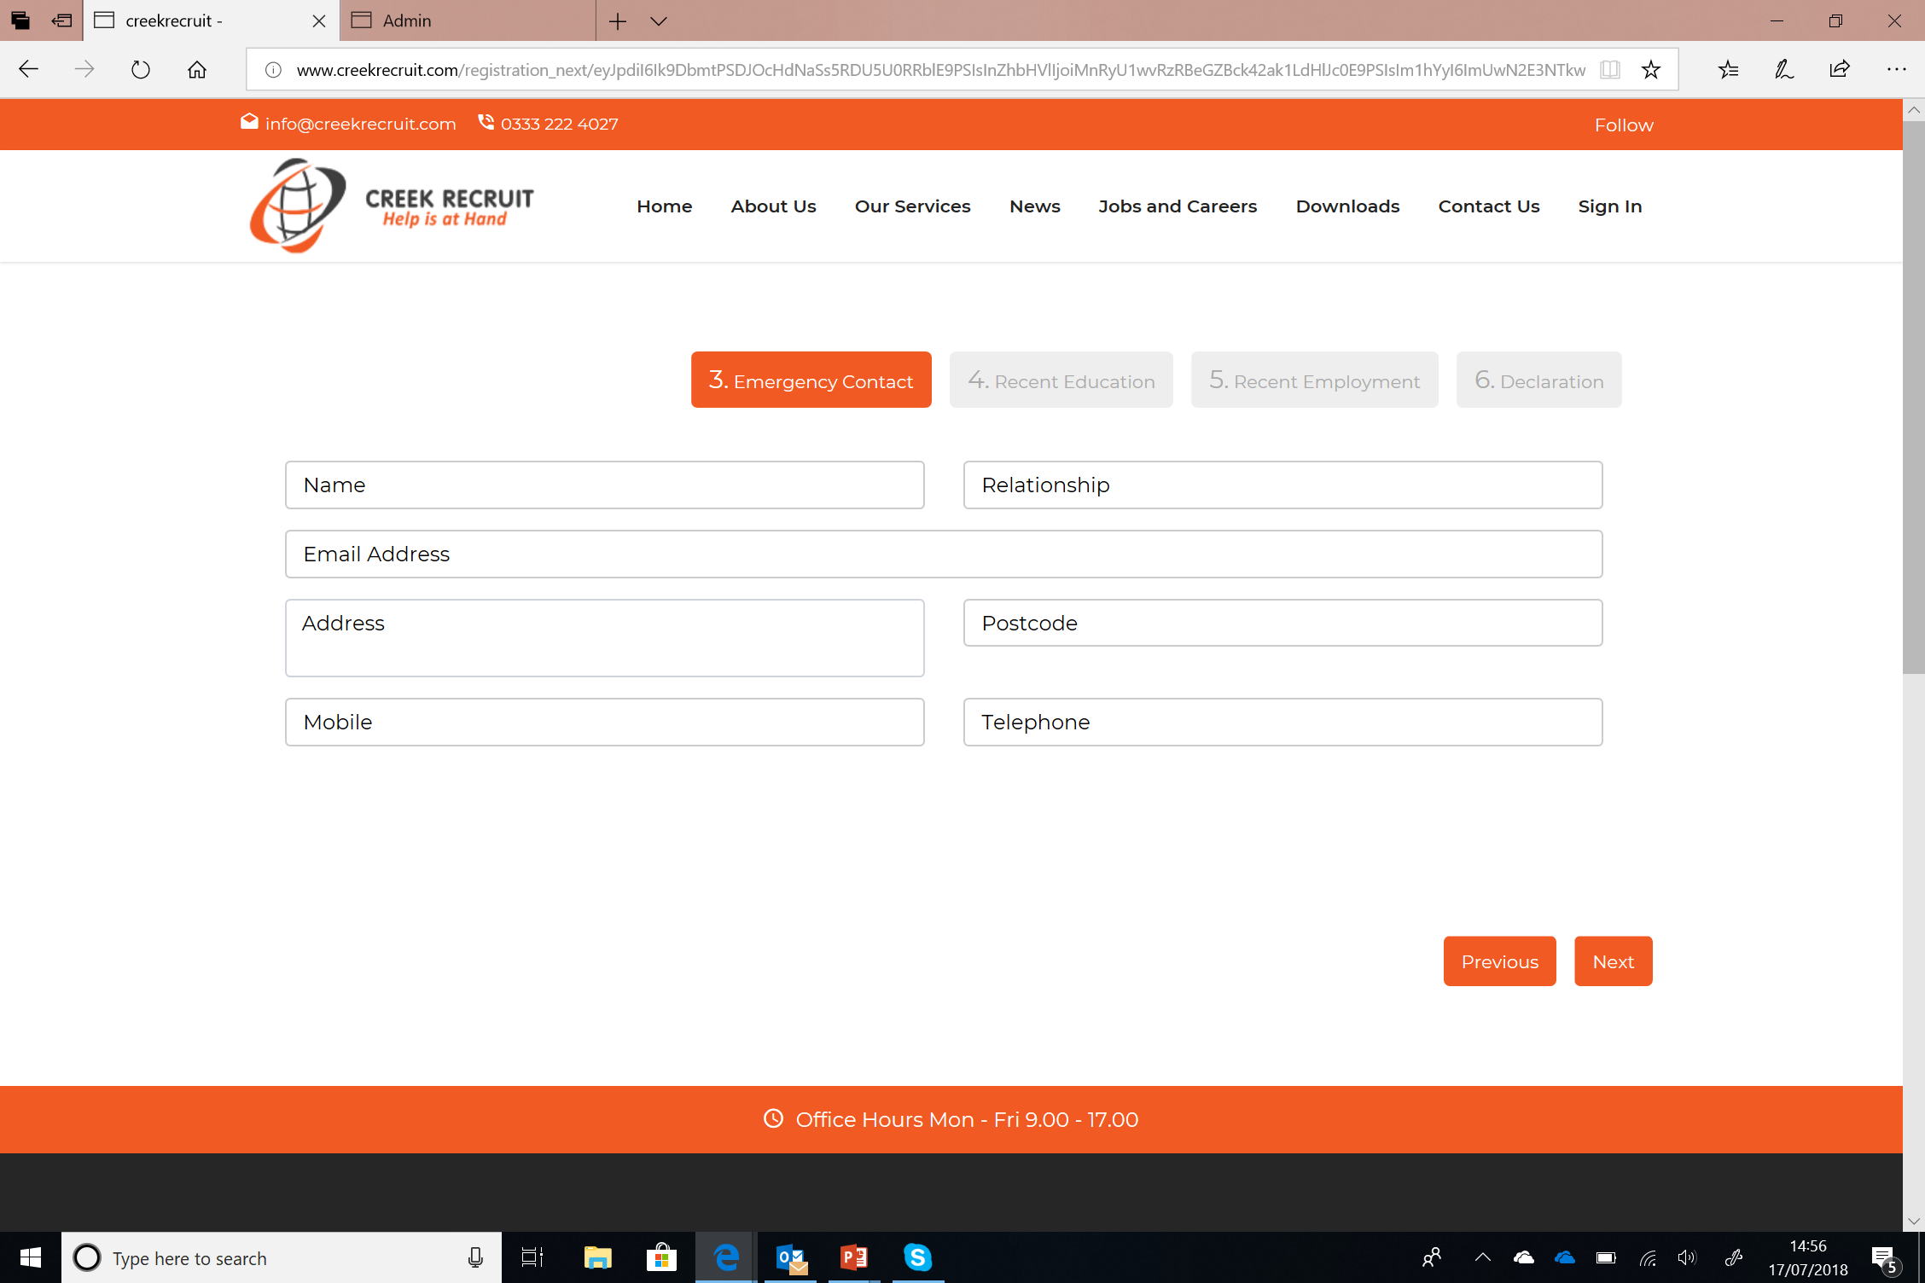
Email address is not mandatory so this can be have the option as don’t have.
The phone number section needs to give permission to move on if either mobile or telephone is filled.

Slide 6
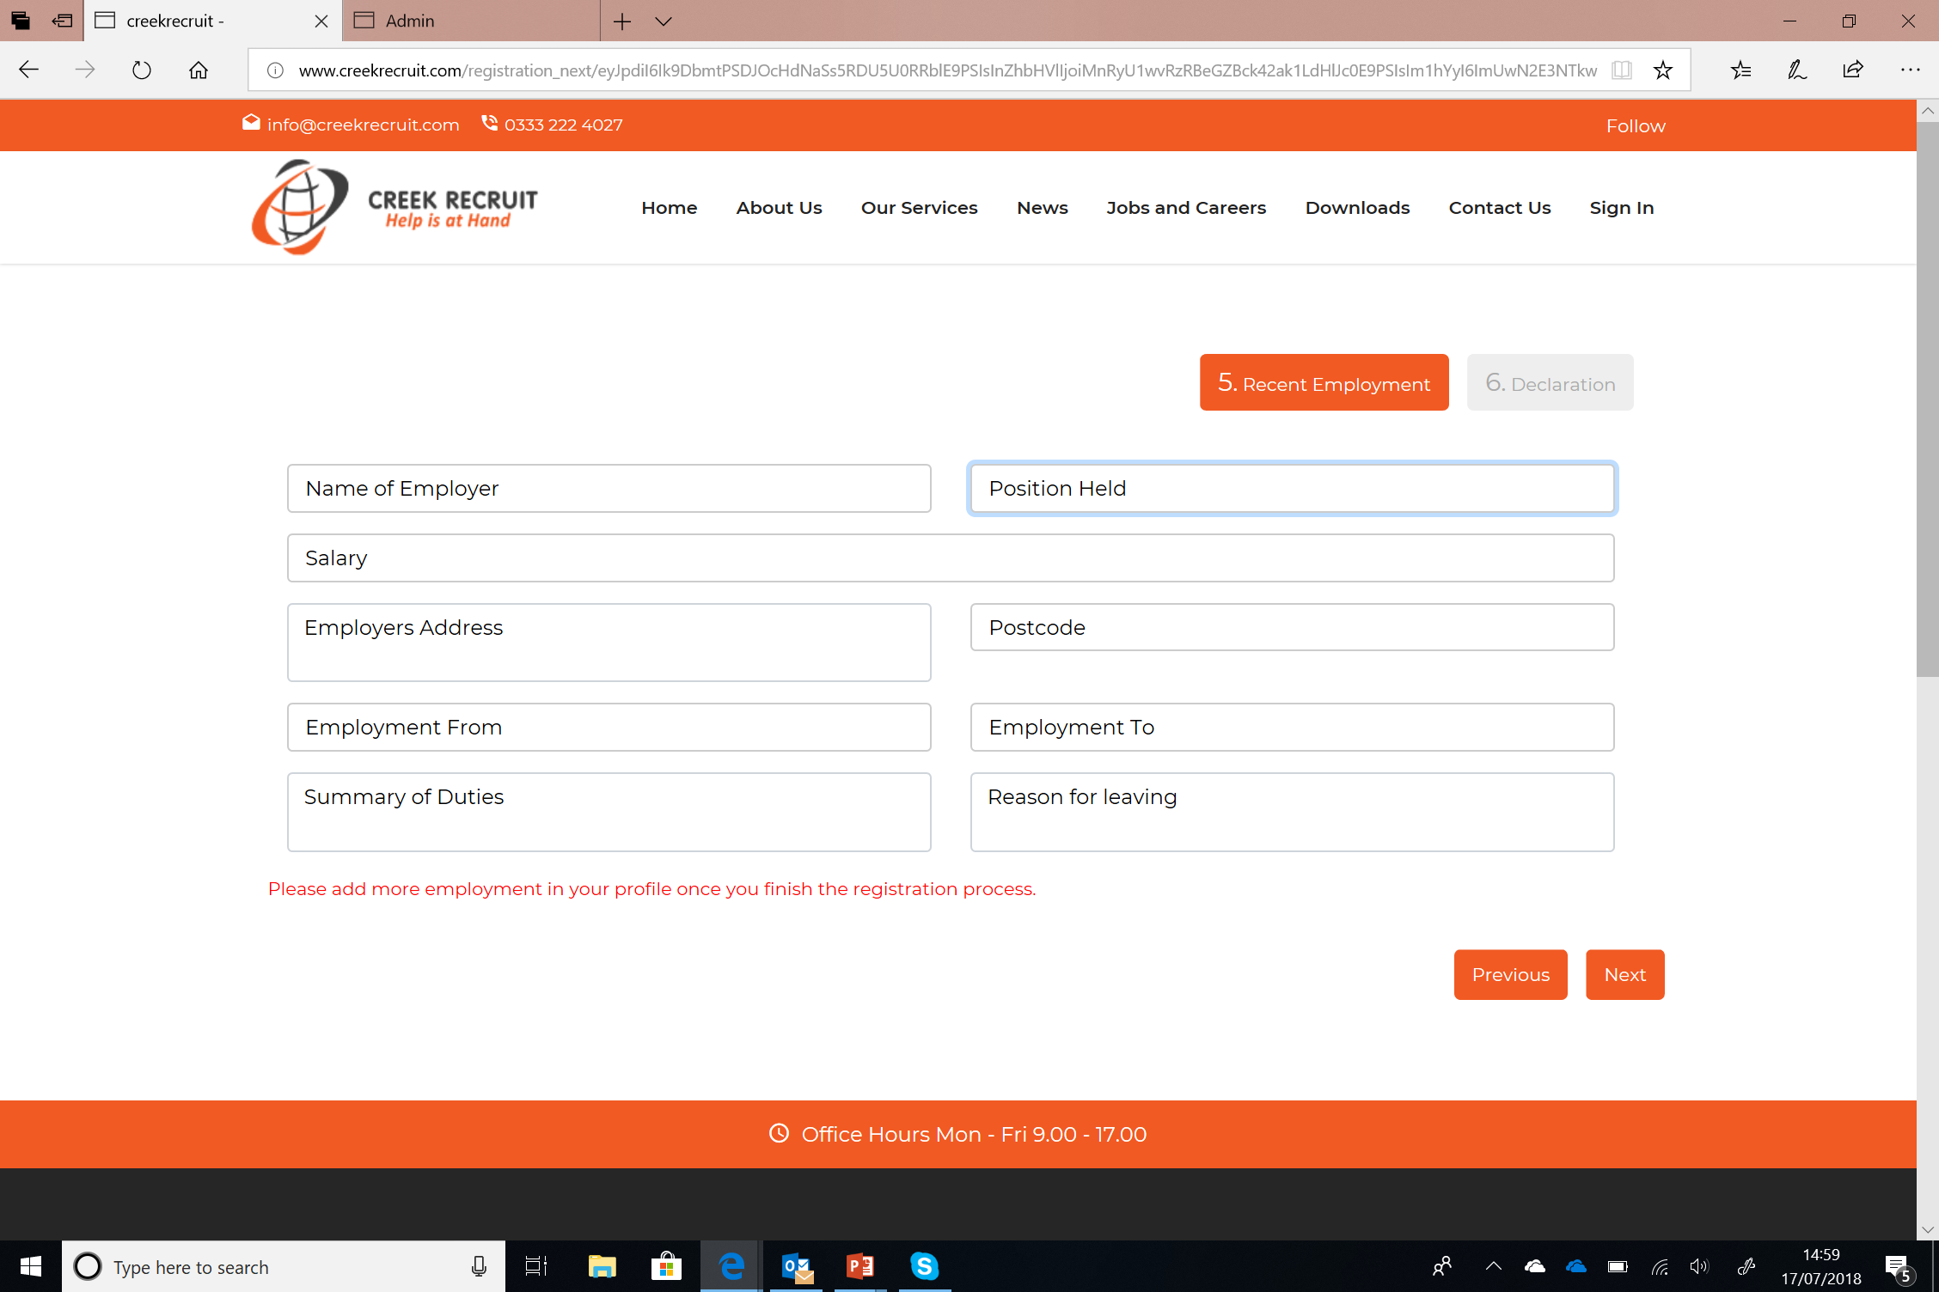
For those who are straight from school, could there be an option to choose N/A please pn all areas here

Slide 7
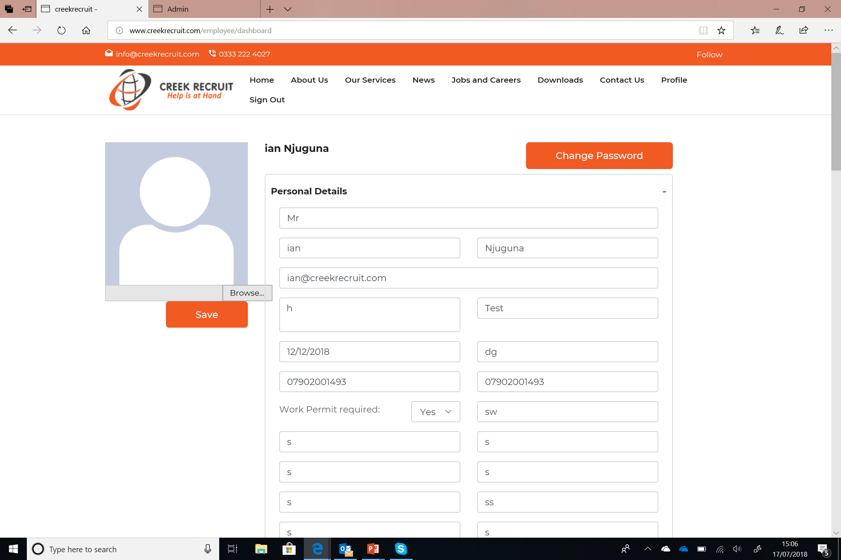
There is a bug when you add the picture. It loads, and shows and then disappears.
Browser bar to long, any other way of doing it maybe have it on the pictures or have the browser bar disappear after page has been uploaded.
This section Belal, is wonderful, other than that bug, this is pure breeze to move around and add and edit information. The CV upload is quick and responsive, and training adding really great too.
Could we have a notification when someone logs in and changes any of their information?

Slide 8
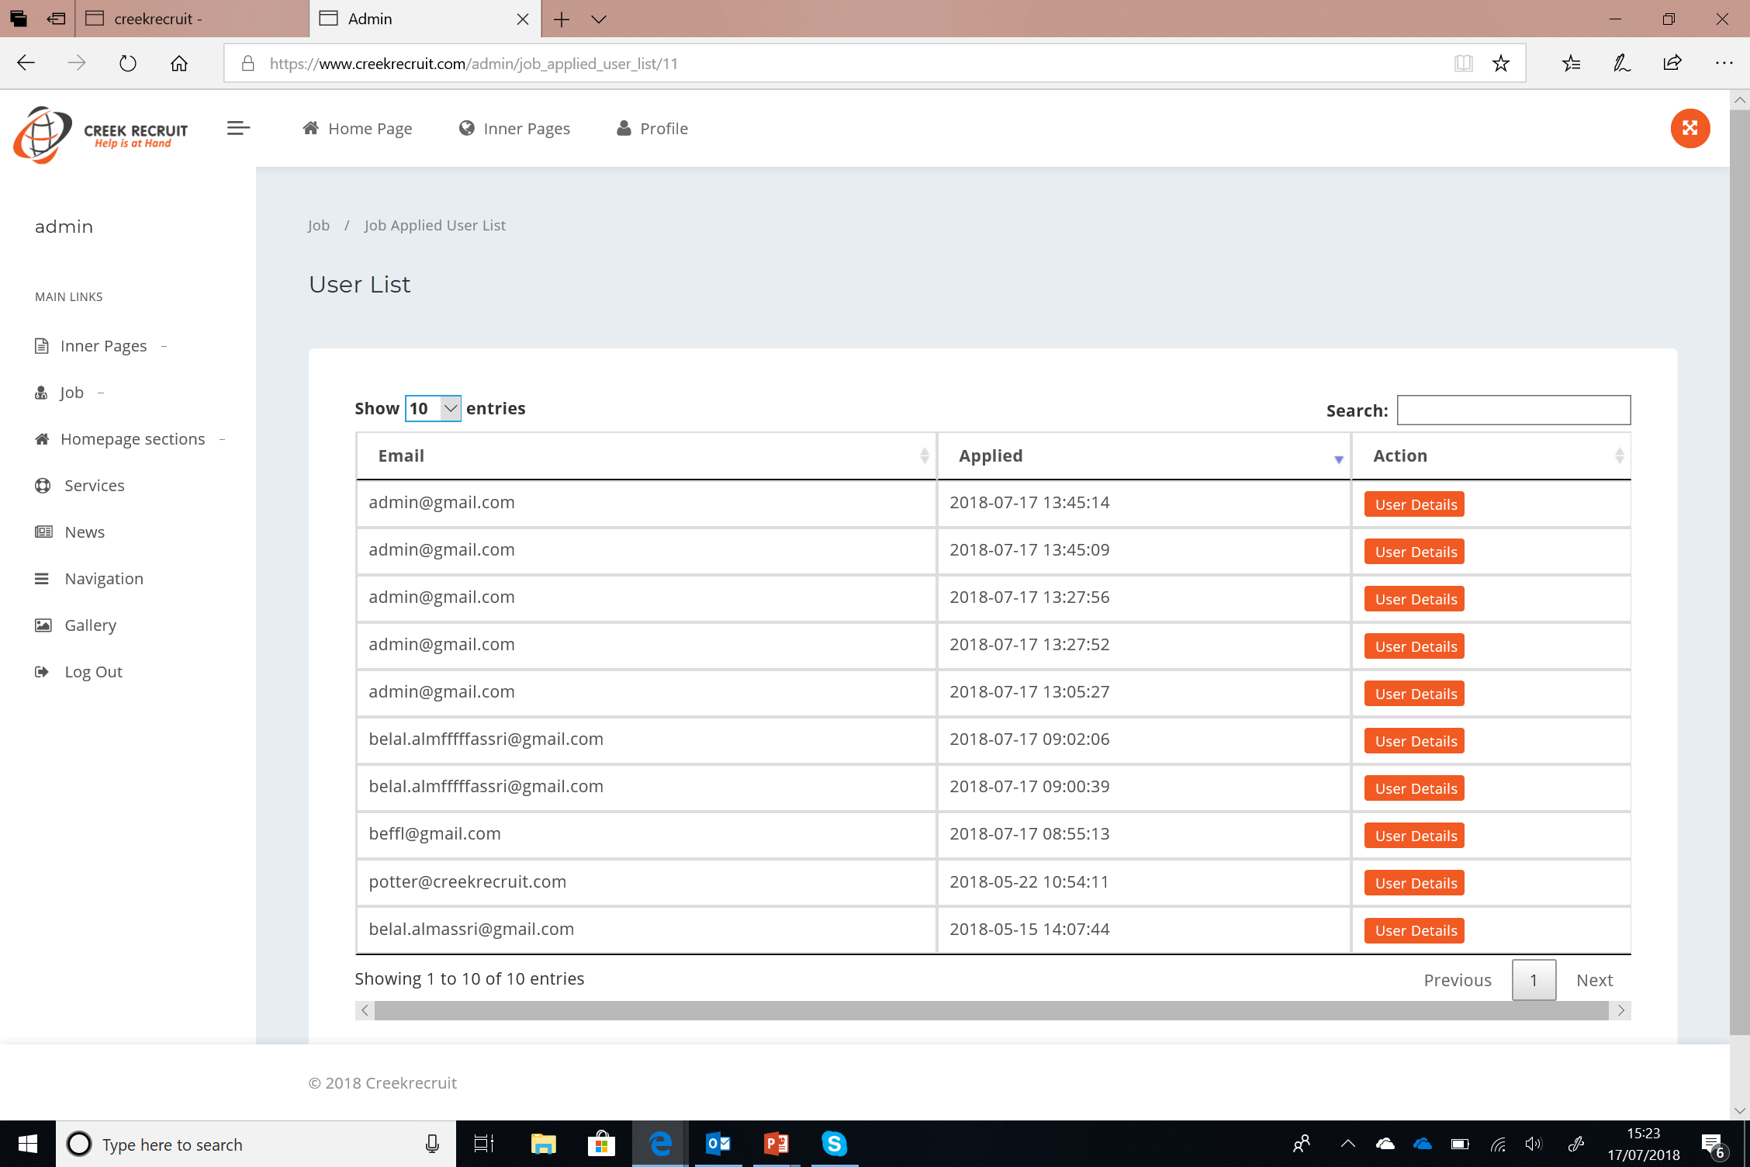
I noted some of the applications are not coming through. I applied as ian@creekrecruit.com

